Slide 1
Pipeline Hazards
Textbook Chapter 4 – The Processor

Slide 2
Pipeline Hazards
“Problems with the instruction pipeline in CPU microarchitectures when the next instruction cannot execute in the following clock cycle and can potentially lead to incorrect computation results.”

Slide 3
Three type of Pipeline Hazards
Structural Hazard
Data Hazard
Control Hazard

Slide 4
Structural Hazard
“The hardware cannot support the combination of instructions that we want to execute in the same clock cycle.”
A structural hazard occurs when two (or more) instructions that are already in pipeline need the same resource
Also known as “Resource Hazard”
Solution:
Increase available resources, such as having multiple ports into main memory
Stall the pipeline (will be discussed in detail later)

Slide 5
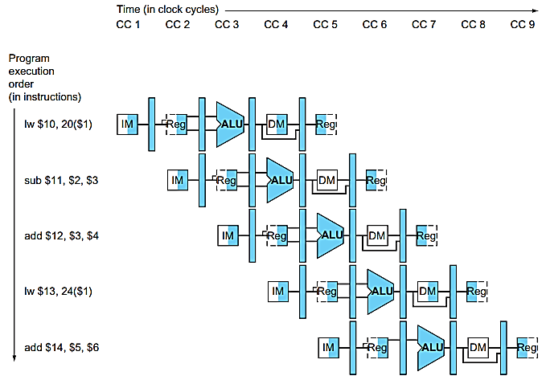
Structural Hazards
In CC4, instruction 1 (lw $10) is reading data from memory while instruction 4 (lw $13…) is being fetched from the memory.
What if we have only one Read Port in Memory?

Slide 6
Data Hazards
Data hazards occur when instructions that exhibit data dependence modify data in different stages of a pipeline.
Example 1
i1. R2 <- R5 + R3
i2. R4 <- R2 + R3
Example 2
i1. R4 <- R1 + R5
i2. R5 <- R1 + R2
Example 3
i1. R2 <- R4 + R7
i2. R2 <- R1 + R3

Slide 7
Data Hazards
Data hazards occur when instructions that exhibit data dependence modify data in different stages of a pipeline.
1- Read after Write (RAW)
i1. R2 <- R5 + R3
i2. R4 <- R2 + R3
2- Write after Read (WAR)
i1. R4 <- R1 + R5
i2. R5 <- R1 + R2
3- Write after Write (WAW)
i1. R2 <- R4 + R7
i2. R2 <- R1 + R3
Not Possible in this design
Not Possible in this design
Notes:
RAW: The first instruction is calculating a value to be saved in register R2, and the second is going to use this value to compute a result for register R4. However, in a pipeline, when operands are fetched for the 2nd operation, the results from the first have not yet been saved, and hence a data dependency occurs.
A data dependency occurs with instruction i2, as it is dependent on the completion of instruction i1.
WAR: In any situation with a chance that i2 may finish before i1 (i.e., with concurrent execution), it must be ensured that the result of register R5 is not stored before i1 has had a chance to fetch the operands.
WAW: The write back (WB) of i2 must be delayed until i1 finishes executing.

Slide 8
Data Hazards – Example 1
 | CC1 | CC2 | CC3 | CC4 | CC5 | CC6 | CC7
R2 <- R5 + R3 | IF | ID | EX | MEM | WB
R4 <- R2 + R3 |  | IF | ID | EX | MEM | WB
Suppose in Register File
R2 = 5
R3 = 10
R5 = 20
i1. R2 <- R5 + R3
R2 = 20 + 10 = 30
i2. R4 <- R2 + R3
R4 = 30 + 10 = 40

Slide 9
Data Hazards – Example 1 (contd.)
 | CC1 | CC2 | CC3 | CC4 | CC5 | CC6 | CC7
R2 <- R5 + R3 | IF | ID | EX | MEM | WB
R4 <- R2 + R3 |  | IF | ID | EX | MEM | WB
Suppose in Register File
R2 = 5
R3 = 10
R5 = 20
i1. R2 <- R5 + R3
R2 = 20 + 10 = 30
i2. R4 <- R2 + R3
R4 = 30 + 10 = 40
In time, when exactly the R2’s updated data (30) will be available for i2 ?
What exact data i2 is using for calculation?
Notes:
Answer: In the 2nd half of CC5 and so on.

Slide 10
Data Hazards – Example 1 (contd.)
 | CC1 | CC2 | CC3 | CC4 | CC5 | CC6 | CC7
R2 <- R5 + R3 | IF | ID R2 = 5 R3 = 10 R5 = 20 | EX 10+20 = 30 | MEM | WB R2 = 30
R4 <- R2 + R3 |  | IF | ID R2 = ? R3 = 10 | EX ? + 10 = ? | MEM | WB R4 = ?
In time, when exactly the R2’s updated data (30) will be available for i2 ?
What exact data i2 is using for calculation?

Slide 11
Data Hazards – Example 1 (contd.)
 | CC1 | CC2 | CC3 | CC4 | CC5 | CC6 | CC7
R2 <- R5 + R3 | IF | ID R2 = 5 R3 = 10 R5 = 20 | EX 10+20 = 30 | MEM | WB R2 = 30
R4 <- R2 + R3 |  | IF | ID R2 = 5 R3 = 10 | EX 5 + 10 = 15 | MEM | WB R4 = 15
Expected Behavior of I2 |  | IF | ID R2 = 30 R3 = 10 | EX 30 + 10 = 40 | MEM | WB R4 = 40
In time, when exactly the R2’s updated data (30) will be available for i2 ?
What exact data i2 is using for calculation?

Slide 12
Data Hazards – Example 1 (contd.) Solution - Forwarding
 | CC1 | CC2 | CC3 | CC4 | CC5 | CC6 | CC7
R2 <- R5 + R3 | IF | ID R2 = 5 R3 = 10 R5 = 20 | EX 10+20 = 30 | MEM | WB R2 = 30
R4 <- R2 + R3 |  | IF | ID R2 = 5 R3 = 10 | EX 30 + 10 = 40 | MEM | WB R4 = 40
What if we use 30 calculated at CC3 in i2’s calculation (EX) at CC4?
This is called Forwarding.

Slide 13
Data Hazards – Example 1 (contd.) Solution - Forwarding
 | CC1 | CC2 | CC3 | CC4 | CC5 | CC6 | CC7
R2 <- R5 + R3 | IF | ID R2 = 5 R3 = 10 R5 = 20 | EX 10+20 = 30 | MEM | WB R2 = 30
R4 <- R2 + R3 |  | IF | ID R2 = 5 R3 = 10 | EX 30 + 10 = 40 | MEM | WB R4 = 40
R6 <- R2 - R5
Practice Problem: Fill in the pipeline sequence for instruction 3

Slide 14
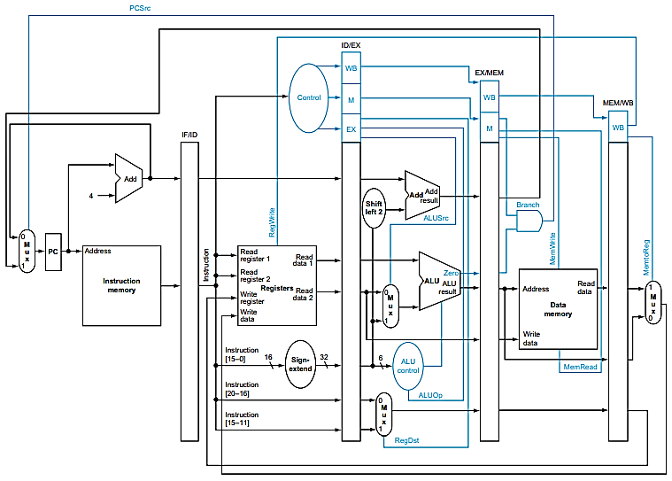
Pipelined Datapath
What modification is required in this design for Forwarding?
Where do we need to add Forwarding Unit?
What Inputs it will take?
What Outputs it will produce?
What function it will perform?
Notes:
FIGURE 4.51 The pipelined datapath of Figure 4.46, with the control signals connected to the control portions of the pipeline registers. Th e control values for the last three stages are created during the instruction decode stage and then placed in the ID/EX pipeline register. Th e control lines for each pipe stage are used, and remaining control lines are then passed to the next pipeline stage.

Slide 15
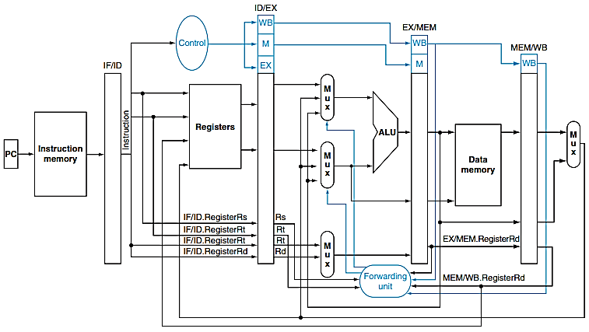
Forwarding Unit
1- Explain each input and output line of the Forwarding Unit and its reason?
2- What are the 2 MUXs and their 3 inputs for (before ALU)?
Notes:
FIGURE 4.56 The datapath modified to resolve hazards via forwarding. Compared with the datapath in Figure 4.51, the additions are the multiplexors to the inputs to the ALU. Th is fi gure is a more stylized drawing, however, leaving out details from the full datapath, such as the branch hardware and the sign extension hardware.

Slide 16
Data Hazards – Example 3
Identify dependences in the code given below:
sub $2, $1,$3 # Register $2 written by sub
and $12,$2,$5 # 1st operand($2) depends on sub
or $13,$6,$2 # 2nd operand($2) depends on sub
add $14,$2,$2 # 1st($2) & 2nd($2) depend on sub
sw $15,100($2) # Base ($2) depends on sub

Slide 17
Data Hazards – Example 3
Solution - Identify dependences in the code given below:
sub $2, $1,$3 # Register $2 written by sub
and $12,$2,$5 # 1st operand($2) depends on sub
or $13,$6,$2 # 2nd operand($2) depends on sub
add $14,$2,$2 # 1st($2) & 2nd($2) depend on sub
sw $15,100($2) # Base ($2) depends on sub

Slide 18
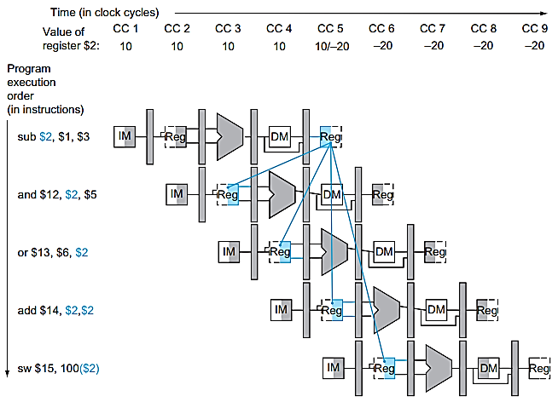
Data Hazards – Example 3 Pipeline Dependences
Notes:
FIGURE 4.52 Pipelined dependences in a fi ve-instruction sequence using simplifi ed datapaths to show the dependences. All the dependent actions are shown in color, and “CC 1” at the top of the fi gure means clock cycle 1. Th e fi rst instruction writes into $2, and all the following instructions read $2. Th is register is written in clock cycle 5, so the proper value is unavailable before clock cycle 5. (A read of a register during a clock cycle returns the value written at the end of the fi rst half of the cycle, when such a write occurs.) Th e colored lines from the top datapath to the lower ones show the dependences. Th ose that must go backward in time are pipeline data hazards

Slide 19
Data Hazards – Example 3 Pipeline Dependences
And this?
What does this mean?
Notes:
FIGURE 4.52 Pipelined dependences in a fi ve-instruction sequence using simplifi ed datapaths to show the dependences. All the dependent actions are shown in color, and “CC 1” at the top of the fi gure means clock cycle 1. Th e fi rst instruction writes into $2, and all the following instructions read $2. Th is register is written in clock cycle 5, so the proper value is unavailable before clock cycle 5. (A read of a register during a clock cycle returns the value written at the end of the fi rst half of the cycle, when such a write occurs.) Th e colored lines from the top datapath to the lower ones show the dependences. Th ose that must go backward in time are pipeline data hazards

Slide 20
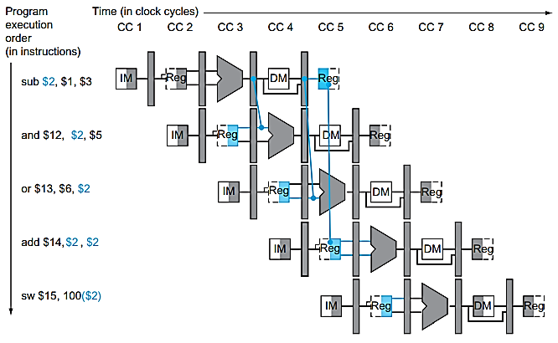
Data Hazards – Example 3 Solution: Forwarding
Notes:
FIGURE 4.53 The dependences between the pipeline registers move forward in time, so it is possible to supply the inputs to the ALU needed by the AND instruction and OR instruction by forwarding the results found in the pipeline registers. Th e values in the pipeline registers show that the desired value is available before it is written into the register fi le. We assume that the register fi le forwards values that are read and written during the same clock cycle, so the add does not stall, but the values come from the register fi le instead of a pipeline register. Register fi le “forwarding”—that is, the read gets the value of the write in that clock cycle—is why clock cycle 5 shows register $2 having the value 10 at the beginning and −20 at the end of the clock cycle. As in the rest of this section, we handle all forwarding except for the value to be stored by a store instruction.

Slide 21
Data Hazards – Example 3 Solution: Forwarding
1- When the instruction can decide that it needs forwarding?
2- Why are these taking forwarded data at EX stage?
3- On which line(s) we need forwarded data?
4- From which pipeline register “and” is getting data?
5- Why “or $13,$6,$2” is not taking data from same pipeline register?
6- What will be the content of EX/MEM pipeline register at the tick
between cc3 and cc4
Between cc4 and cc5
What is happening in EX stage at cc4
7- Do we need forwarding in instruction 4 and 5? Why?
Why are these taking
forwarded data at EX?
Notes:
FIGURE 4.53 The dependences between the pipeline registers move forward in time, so it is possible to supply the inputs to the ALU needed by the AND instruction and OR instruction by forwarding the results found in the pipeline registers. Th e values in the pipeline registers show that the desired value is available before it is written into the register fi le. We assume that the register fi le forwards values that are read and written during the same clock cycle, so the add does not stall, but the values come from the register fi le instead of a pipeline register. Register fi le “forwarding”—that is, the read gets the value of the write in that clock cycle—is why clock cycle 5 shows register $2 having the value 10 at the beginning and −20 at the end of the clock cycle. As in the rest of this section, we handle all forwarding except for the value to be stored by a store instruction.

Slide 22
Forwarding Unit Functionality at CC4
add $14,$2,$2
or $13,$6,$2
and $12,$2,$5
sub $2, $1, $3
(Sub result is -20)
Prev Value of $2
-20
-20
(-20)
and $12,$2,$5
sub $2, $1, $3
$2
$2
$2
$2
$2
Notes:
FIGURE 4.56 The datapath modified to resolve hazards via forwarding. Compared with the datapath in Figure 4.51, the additions are the multiplexors to the inputs to the ALU. Th is fi gure is a more stylized drawing, however, leaving out details from the full datapath, such as the branch hardware and the sign extension hardware.

Slide 23
Forwarding Unit Functionality at CC4
sw $15,100($2)
add $14,$2,$2
or $13,$6,$2
and $12,$2,$5
sub $2, $1, $3
(Sub result is -20)
Prev Value of $2
(-20)
-20
or $13,$6,$2
-20
and $12,$2,$5
sub $2, $1, $3
$2
$2
$2
$2
$2
-20
Notes:
FIGURE 4.56 The datapath modified to resolve hazards via forwarding. Compared with the datapath in Figure 4.51, the additions are the multiplexors to the inputs to the ALU. Th is fi gure is a more stylized drawing, however, leaving out details from the full datapath, such as the branch hardware and the sign extension hardware.

Slide 24
EX Data Hazard – Solution: Forwarding
As soon as the ALU creates the sum for the add, we can supply it as an input for the subtract.
Forwarding or Bypassing: Adding extra hardware to retrieve the missing item early from the internal resources (buffers) is called forwarding or bypassing.

Slide 25
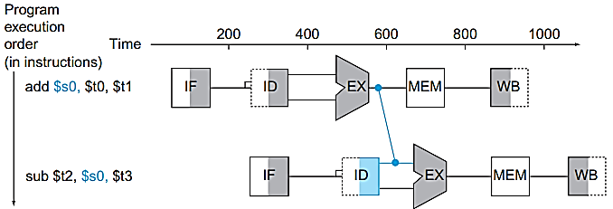
Data Hazards – Example 2 Solution - Forwarding
CC1
CC2
CC3
CC4
CC5
S0 = 10+20
S0 = 30
t2 = 30-5
t2 = 25
Assume S0 is 1 initially
Notes:
FIGURE 4.29 Graphical representation of forwarding. Th e connection shows the forwarding path from the output of the EX stage of add to the input of the EX stage for sub, replacing the value from register $s0 read in the second stage of sub.

Slide 26
Data Hazards – Example 2 Solution - Forwarding
CC1
CC2
CC3
CC4
CC5
10
30
20
S0 = 10+20
S0 = 30
30
1
5
t2 = 30-5
t2 = 25
Assume s0 is 1 initially
Notes:
FIGURE 4.29 Graphical representation of forwarding. Th e connection shows the forwarding path from the output of the EX stage of add to the input of the EX stage for sub, replacing the value from register $s0 read in the second stage of sub.

Slide 27
Data Hazards
Data hazards occur when instructions that exhibit data dependence modify data in different stages of a pipeline.
Example 1
i1. R2 <- R5 + R3
i2. R4 <- R2 + R3
Example 2
i1. R4 <- R1 + R5
i2. R5 <- R1 + R2
Example 3
i1. R2 <- R4 + R7
i2. R2 <- R1 + R3

Slide 28
Data Hazards
Data hazards occur when instructions that exhibit data dependence modify data in different stages of a pipeline.
1- Read after Write (RAW)
i1. R2 <- R5 + R3
i2. R4 <- R2 + R3
2- Write after Read (WAR)
i1. R4 <- R1 + R5
i2. R5 <- R1 + R2
3- Write after Write (WAW)
i1. R2 <- R4 + R7
i2. R2 <- R1 + R3
Not Possible in this design
Not Possible in this design
Notes:
RAW: The first instruction is calculating a value to be saved in register R2, and the second is going to use this value to compute a result for register R4. However, in a pipeline, when operands are fetched for the 2nd operation, the results from the first have not yet been saved, and hence a data dependency occurs.
A data dependency occurs with instruction i2, as it is dependent on the completion of instruction i1.
WAR: In any situation with a chance that i2 may finish before i1 (i.e., with concurrent execution), it must be ensured that the result of register R5 is not stored before i1 has had a chance to fetch the operands.
WAW: The write back (WB) of i2 must be delayed until i1 finishes executing.

Slide 29
Reference
David A. Patterson, John L. Hennessy, Computer Organization and Design: The hardware/software interface – Chapter 4.
https://en.wikipedia.org/wiki/Hazard_(computer_architecture)

